Slide 1
Risorse umane diapositiva 1
Screening and selection of candidates
Business and Project Management
Artificial Intelligence and Data Engineering
Student:
Davide Vigna

Slide 2

Risorse umane diapositiva 7
CONTENTS
5%
45%
35%
15%
Introduction
Processing
Clustering
Results
Problem definition
Challenges
Project goal
Dataset
Preprocessing
NLP
Screening of candidates
Clustering tendency
K-Means
DBScan
Salary Segmentation
Candidates Skills Profilation

Slide 3
Risorse umane diapositiva 2
INTRODUCTION
How does it work?
Minimum requirements check
Additional skills analysis
Candidate interview
Decision Making

Slide 4
CHALLENGES
TIME CONSUMING
HIRING QUALITY

Slide 5

Risorse umane diapositiva 8
PROJECT GOAL
Using artificial intelligence to speed up the first two phases.
Screening CVs.
Selecting among bests
Answer to business questions
Salary Segmentation: identification of groups of similar people considering year of experience and education level.
Candidates Skills Profilation: identification of groups of similar people considering versatility in known languages and technical skills.

Slide 6


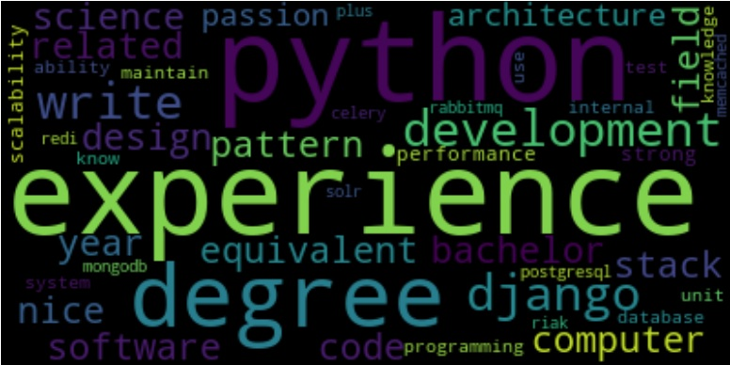
Risorse umane diapositiva 8
DATASET USED
10 000 USA LinkedIn profiles
Job Postings found on Kaggle
&
Considering only one job posting

Slide 7


Risorse umane diapositiva 8
PREPROCESSING
Data Extraction and Features Construction
full name description
country
languages spoken
currently working
numbers of different working experiences
years of working experiences
university
number of degrees
number of accomplishment projects
number of accomplishment courses
number of accomplishment patents
full skills descriptions

Slide 8

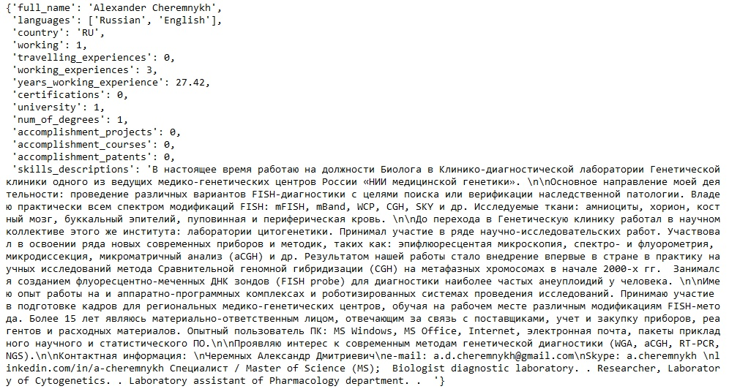
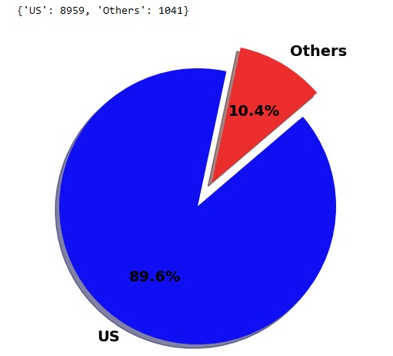
Risorse umane diapositiva 8
PREPROCESSING
Data Cleaning and Data Reduction
Cleaning of not real languages spoken
Reduction of foreign CVs data

Slide 9
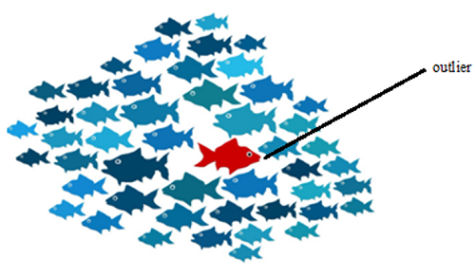
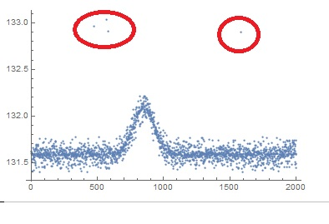
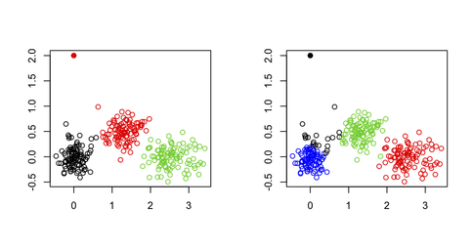
Risorse umane diapositiva 8
PREPROCESSING
Outlier Analysis: how to treat them? Valid data or noise?
removing all CVs with years of experience greater the human life
years of working experience > 40
number of degrees > 10
numbers of different working experiences > 30
Questa foto di Autore sconosciuto è concesso in licenza da CC BY-SA

Slide 10


Risorse umane diapositiva 8
NLP: Natural Language Processing
Applied on textual data: full skills descriptions and single job posting
Regular expression matches
Tokenization
Part of Speech (PoS) tagging
Stopword removal
Lemmatization

Slide 11
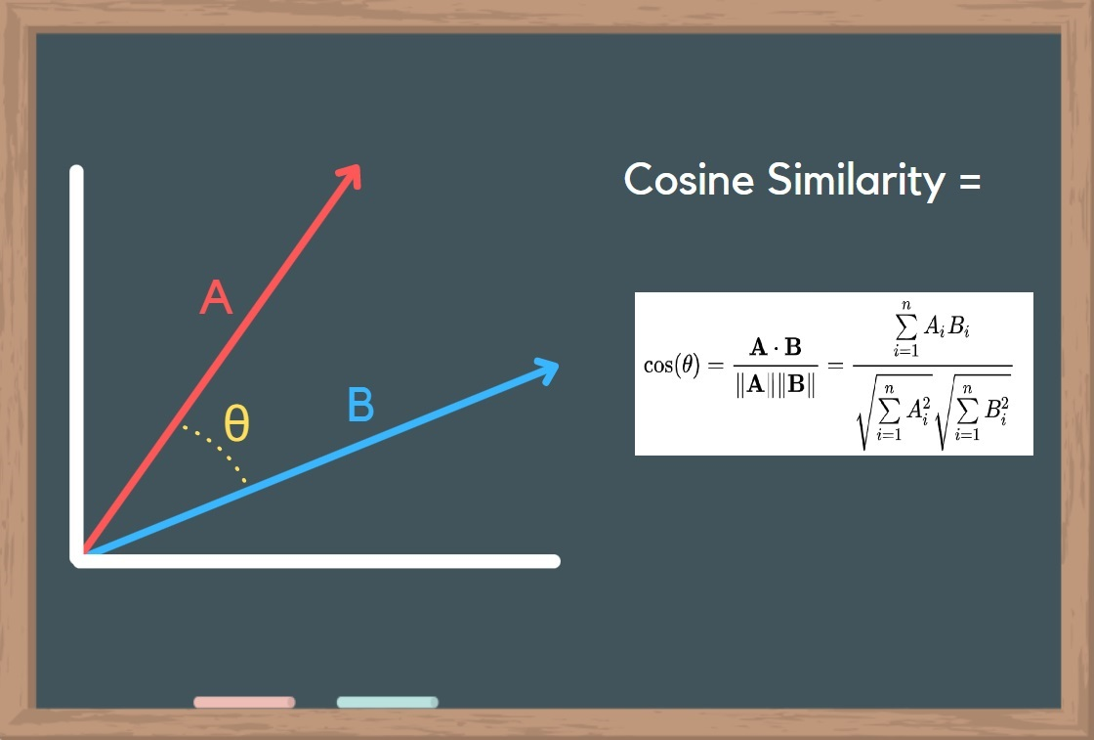
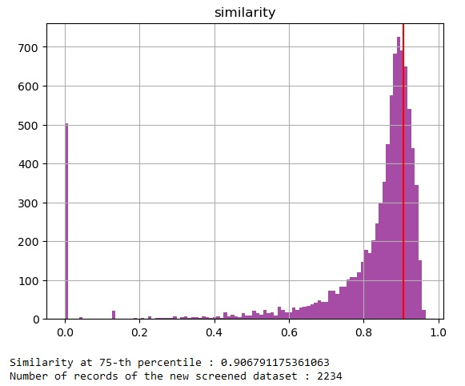
Risorse umane diapositiva 8
SCREENING OF CANDIDATES
Comparing skill description with job posting using word embeddings
SpaCy document similarity: cosine similarity
Additional screening
From 10 000 to 483 CVs

Slide 12
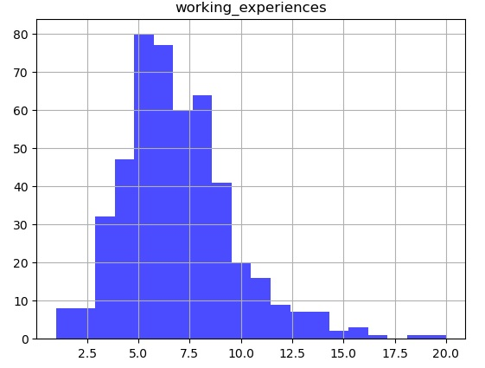
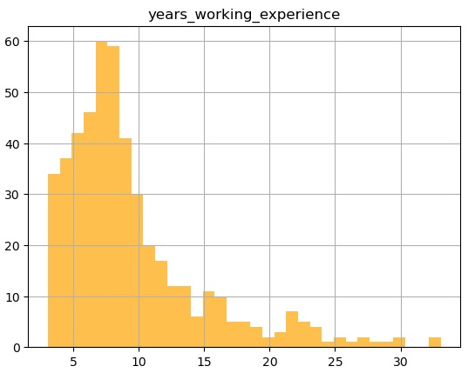
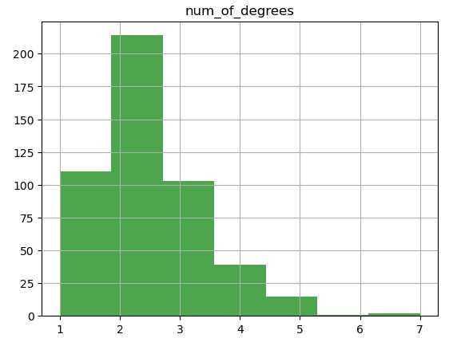
Risorse umane diapositiva 8
SCREENING OF CANDIDATES
Some statistics on the final screened data

Slide 13
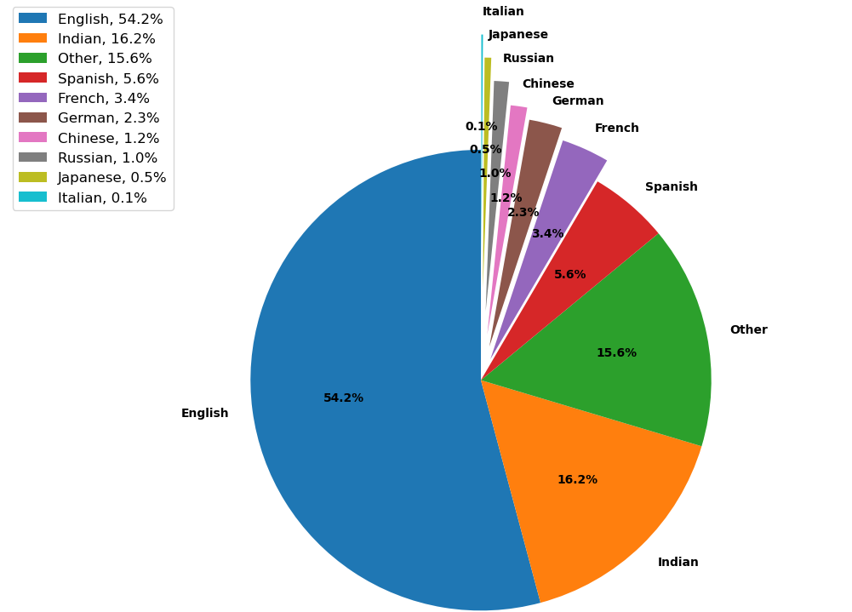
Risorse umane diapositiva 8
SCREENING OF CANDIDATES
Some statistics on the final screened data

Slide 14
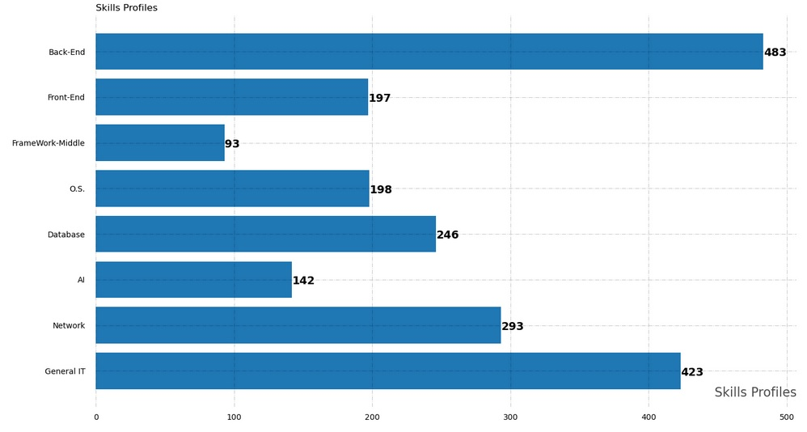
Risorse umane diapositiva 8
SCREENING OF CANDIDATES
Some statistics on the final screened data

Slide 15

Risorse umane diapositiva 8
CLUSTERING
CHARATERISTICS
What is it and why it is useful
It is a technique in machine learning and data analysis used to group similar data points together based on their inherent characteristics or patterns
It is a nice tool helping in selection of candidates
It does not require labeled data for training: unsupervised learning.
The goal of clustering is to partition a dataset into subsets, or clusters, where data points within the same cluster are more similar to each other than to those in other clusters.

Slide 16
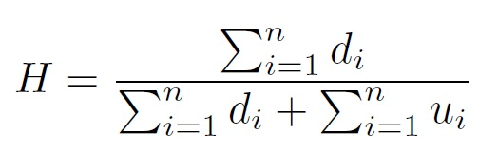
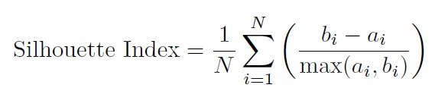
Risorse umane diapositiva 8
CLUSTERING
Preliminary considerations
Hopkins Statistic Test: clustering tendency
Choosing of the algorithm
Partitioning: K-Means (pro&cons)
Density Based: DBSCAN (pro&cons)
Evaluation of the results:
Silhouette Index

Slide 17
Risorse umane diapositiva 8
RESULTS
Salary Segmentation
Candidates Skills Profilation

Slide 18

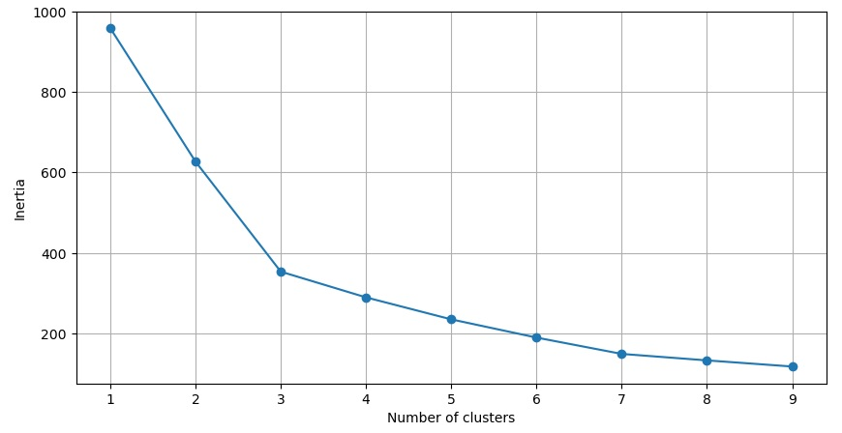
Risorse umane diapositiva 8
SALARY SEGMENTATION
Attributes considered: years working experience and education score
Hopkins Statistic Test: 0.89
Clustering Algorithm: K-Means
Elbow method: K = 3
Silhouette score: 0.47

Slide 19
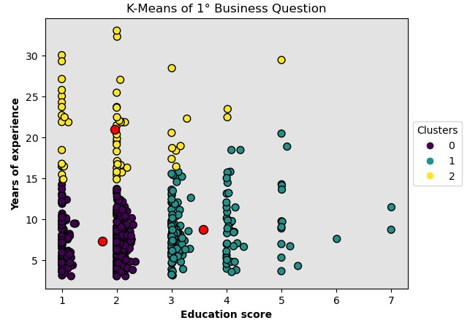
Risorse umane diapositiva 8
SALARY SEGMENTATION

Slide 20
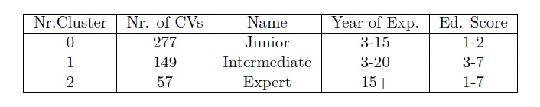
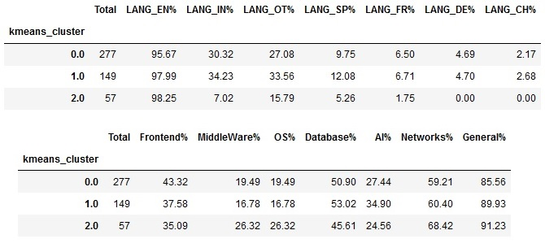
Risorse umane diapositiva 8
SALARY SEGMENTATION

Slide 21
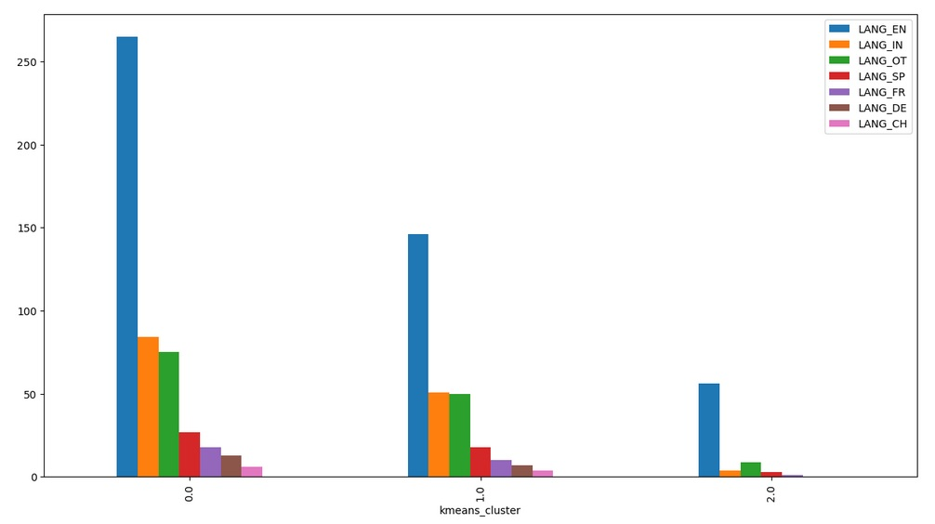
Risorse umane diapositiva 8
SALARY SEGMENTATION

Slide 22
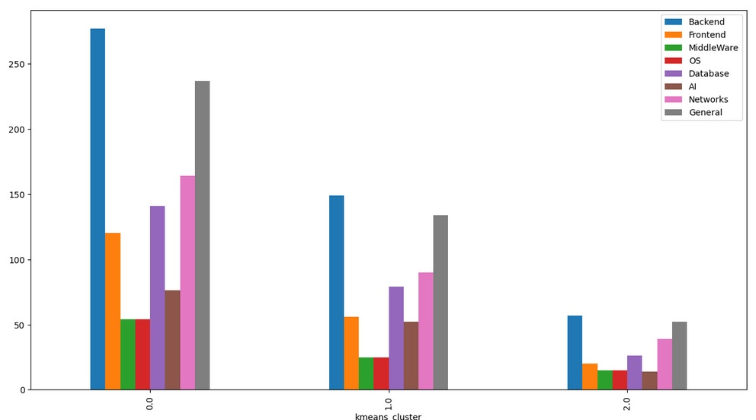
Risorse umane diapositiva 8
SALARY SEGMENTATION

Slide 23



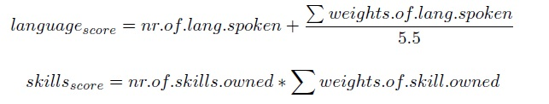
Risorse umane diapositiva 8
CANDIDATES SKILLS PROFILATION
Attributes considered: language score and skill score
Hopkins Statistic Test: 0.84
Clustering Algorithm: DBSCAN
Grid search → eps= 0.29 and minPoints = 3
Silhouette score: 0.50
This analysis is focused on just two languages,
English and Spanish but the others still contribute to the language score.
This means that the MAX of nr.lang spoken is 2.

Slide 24
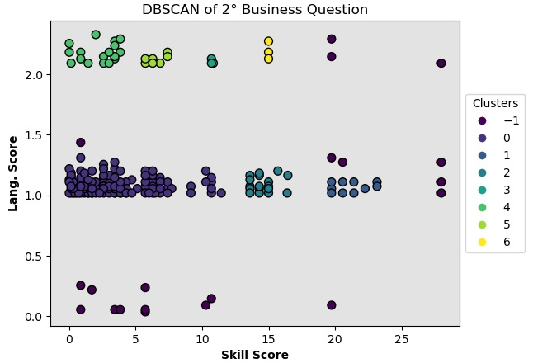
Risorse umane diapositiva 8
CANDIDATES SKILLS PROFILATION

Slide 25
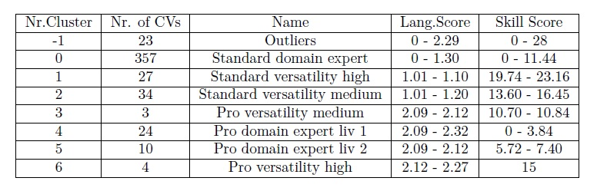
Risorse umane diapositiva 8
CANDIDATES SKILLS PROFILATION

Slide 26
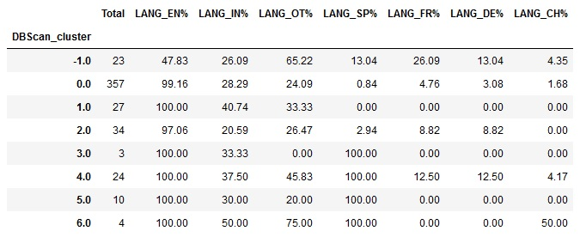
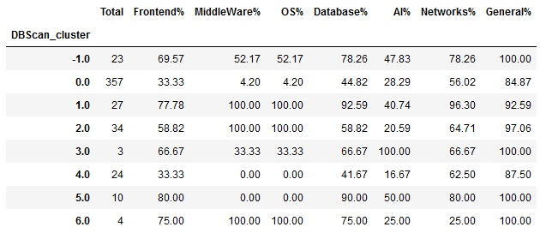
Risorse umane diapositiva 8
CANDIDATES SKILLS PROFILATION

Slide 27



Risorse umane diapositiva 4
CONCLUSIONS

Slide 28
Risorse umane diapositiva 10
Thank you!

